Slide 1
Plants
Year 7 Science

Slide 2

Review
What is the difference between an animal and a fungi?
What does unicellular mean?
Describe protists.
Name four types of arthropods.
Why do we classify living things?
What does MRS GREN stand for?

Slide 3
Learning Intentions
Grouping a variety of organisms on the basis of similarities and differences in particular features

Slide 4
Success criteria
Describe features of the plant kingdom.
Explain photosynthesis.
Use a key to classify plant species.

Slide 5
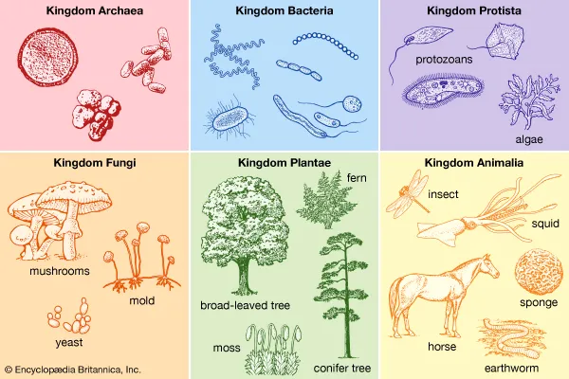

Slide 6
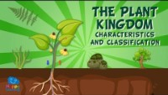

Slide 7
Plants
Can’t move around.
Make their own food (photosynthesis).
Are multicellular.
Have specialised cell structures, such as cell walls, large vacuoles and chloroplasts.

Slide 8
Groups of plants
Plants are classified based on
Their body structures (eg stems, leaves and roots)
Whether they have a vascular system (veins)
How they reproduce (flowers, cones, seeds and fruit).

Slide 9
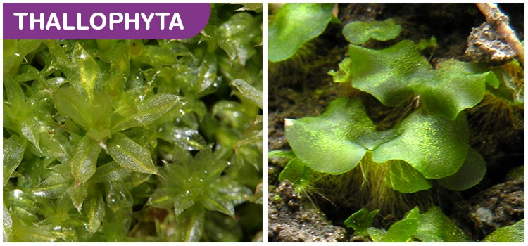

Slide 10
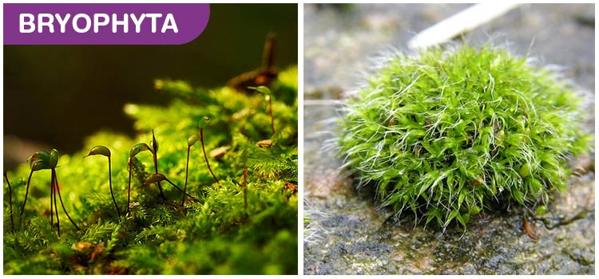

Slide 11
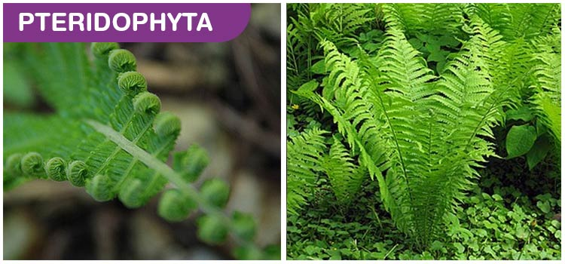

Slide 12
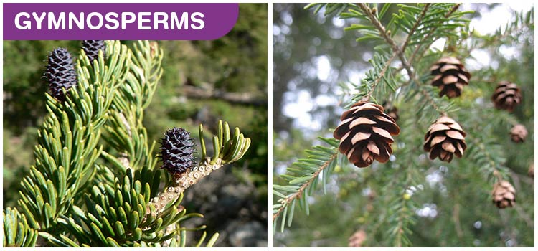

Slide 13
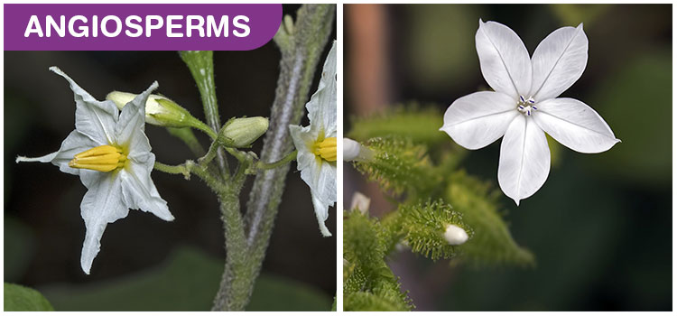

Slide 14
Activity: Plants treasure hunt
RULES:
Time limit
Boundaries
Draw only – no collecting

Slide 15
Success criteria
Describe features of the plant kingdom.
Explain photosynthesis.
Use a key to classify plant species.

